Slide 1

Application Process in MongoDB Ryan Bass and Nicole Wittlin
Notes:
Intro:
From the Top (FTT) is America’s largest national platform dedicated to celebrating the stories, talents, and character of young classically-trained musicians.
The organization’s weekly NPR radio broadcast is the most popular weekly one-hour classical music program on public radio
Its heard on more than 220 stations nationwide by audiences of more than half a million listeners.

Slide 2
Online Application Process
Upwards of 800 applications annually
Solo instrumentalists, vocalists, composers, small ensembles (fewer than 8 musicians), and large ensembles (more than 9 musicians)
Basic contact and demographic information about students, parents, and teachers
Short answer essay questions
Audio and/or video sample performances
$70 fee (credit card information)
Applicants age 8 to 18

Slide 3
Application Process
Upwards of 800 applications annually
Solo instrumentalists, vocalists, composers, small ensembles (fewer than 8 musicians), and large ensembles (more than 9 musicians)
Basic contact and demographic information about students, parents, and teachers
Short answer essay questions
Audio and/or video sample performances
$70 fee (credit card information)
Applicants age 8 to 18

Slide 4
Application Process
Upwards of 800 applications annually
Solo instrumentalists, vocalists, composers, small ensembles (fewer than 8 musicians), and large ensembles (more than 9 musicians)
Basic contact and demographic information about students, parents, and teachers
Short answer essay questions
Audio and/or video sample performances
$70 fee (credit card information)
Applicants age 8 to 18

Slide 5
Application Process
Upwards of 800 applications annually
Solo instrumentalists, vocalists, composers, small ensembles (fewer than 8 musicians), and large ensembles (more than 9 musicians)
Basic contact and demographic information about students, parents, and teachers
Short answer essay questions
Audio and/or video sample performances
$70 fee (credit card information)
Applicants age 8 to 18

Slide 6
Application Process
Upwards of 800 applications annually
Solo instrumentalists, vocalists, composers, small ensembles (fewer than 8 musicians), and large ensembles (more than 9 musicians)
Basic contact and demographic information about students, parents, and teachers
Short answer essay questions
Audio and/or video sample performances
$70 fee (credit card information)
Applicants age 8 to 18

Slide 7
Application Process
Upwards of 800 applications annually
Solo instrumentalists, vocalists, composers, small ensembles (fewer than 8 musicians), and large ensembles (more than 9 musicians)
Basic contact and demographic information about students, parents, and teachers
Short answer essay questions
Audio and/or video sample performances
$70 fee (credit card information)
Applicants age 8 to 18

Slide 8
Application Process
Upwards of 800 applications annually
Solo instrumentalists, vocalists, composers, small ensembles (fewer than 8 musicians), and large ensembles (more than 9 musicians)
Basic contact and demographic information about students, parents, and teachers
Short answer essay questions
Audio and/or video sample performances
$70 fee (credit card information)
Applicants age 8 to 18

Slide 9
System Requirements
Collect, store, and retrieve text-based information
Accept, catalogue, and store audio and video files
Securely store credit cards for application fee
Compliant with personally identifiable information protocols and the Massachusetts Data Protection Act
Balance need for strict security with FTT’s limited technological capacity
Meet budget constraints

Slide 10
System Requirements
Collect, store, and retrieve text-based information
Accept, catalogue, and store audio and video files
Securely store credit cards for application fee
Compliant with personally identifiable information protocols and the Massachusetts Data Protection Act
Balance need for strict security with FTT’s limited technological capacity
Meet budget constraints

Slide 11
System Requirements
Collect, store, and retrieve text-based information
Accept, catalogue, and store audio and video files
Securely store credit cards for application fee
Compliant with personally identifiable information protocols and the Massachusetts Data Protection Act
Balance need for strict security with FTT’s limited technological capacity
Meet budget constraints

Slide 12
System Requirements
Collect, store, and retrieve text-based information
Accept, catalogue, and store audio and video files
Securely store credit cards for application fee
Compliant with personally identifiable information protocols and the Massachusetts Data Protection Act
Balance need for strict security with FTT’s limited technological capacity
Meet budget constraints

Slide 13
System Requirements
Collect, store, and retrieve text-based information
Accept, catalogue, and store audio and video files
Securely store credit cards for application fee
Compliant with personally identifiable information protocols and the Massachusetts Data Protection Act
Balance need for strict security with FTT’s limited technological capacity
Meet budget constraints

Slide 14
System Requirements
Collect, store, and retrieve text-based information
Accept, catalogue, and store audio and video files
Securely store credit cards for application fee
Compliant with personally identifiable information protocols and the Massachusetts Data Protection Act
Balance need for strict security with FTT’s limited technological capacity
Meet budget constraints

Slide 15
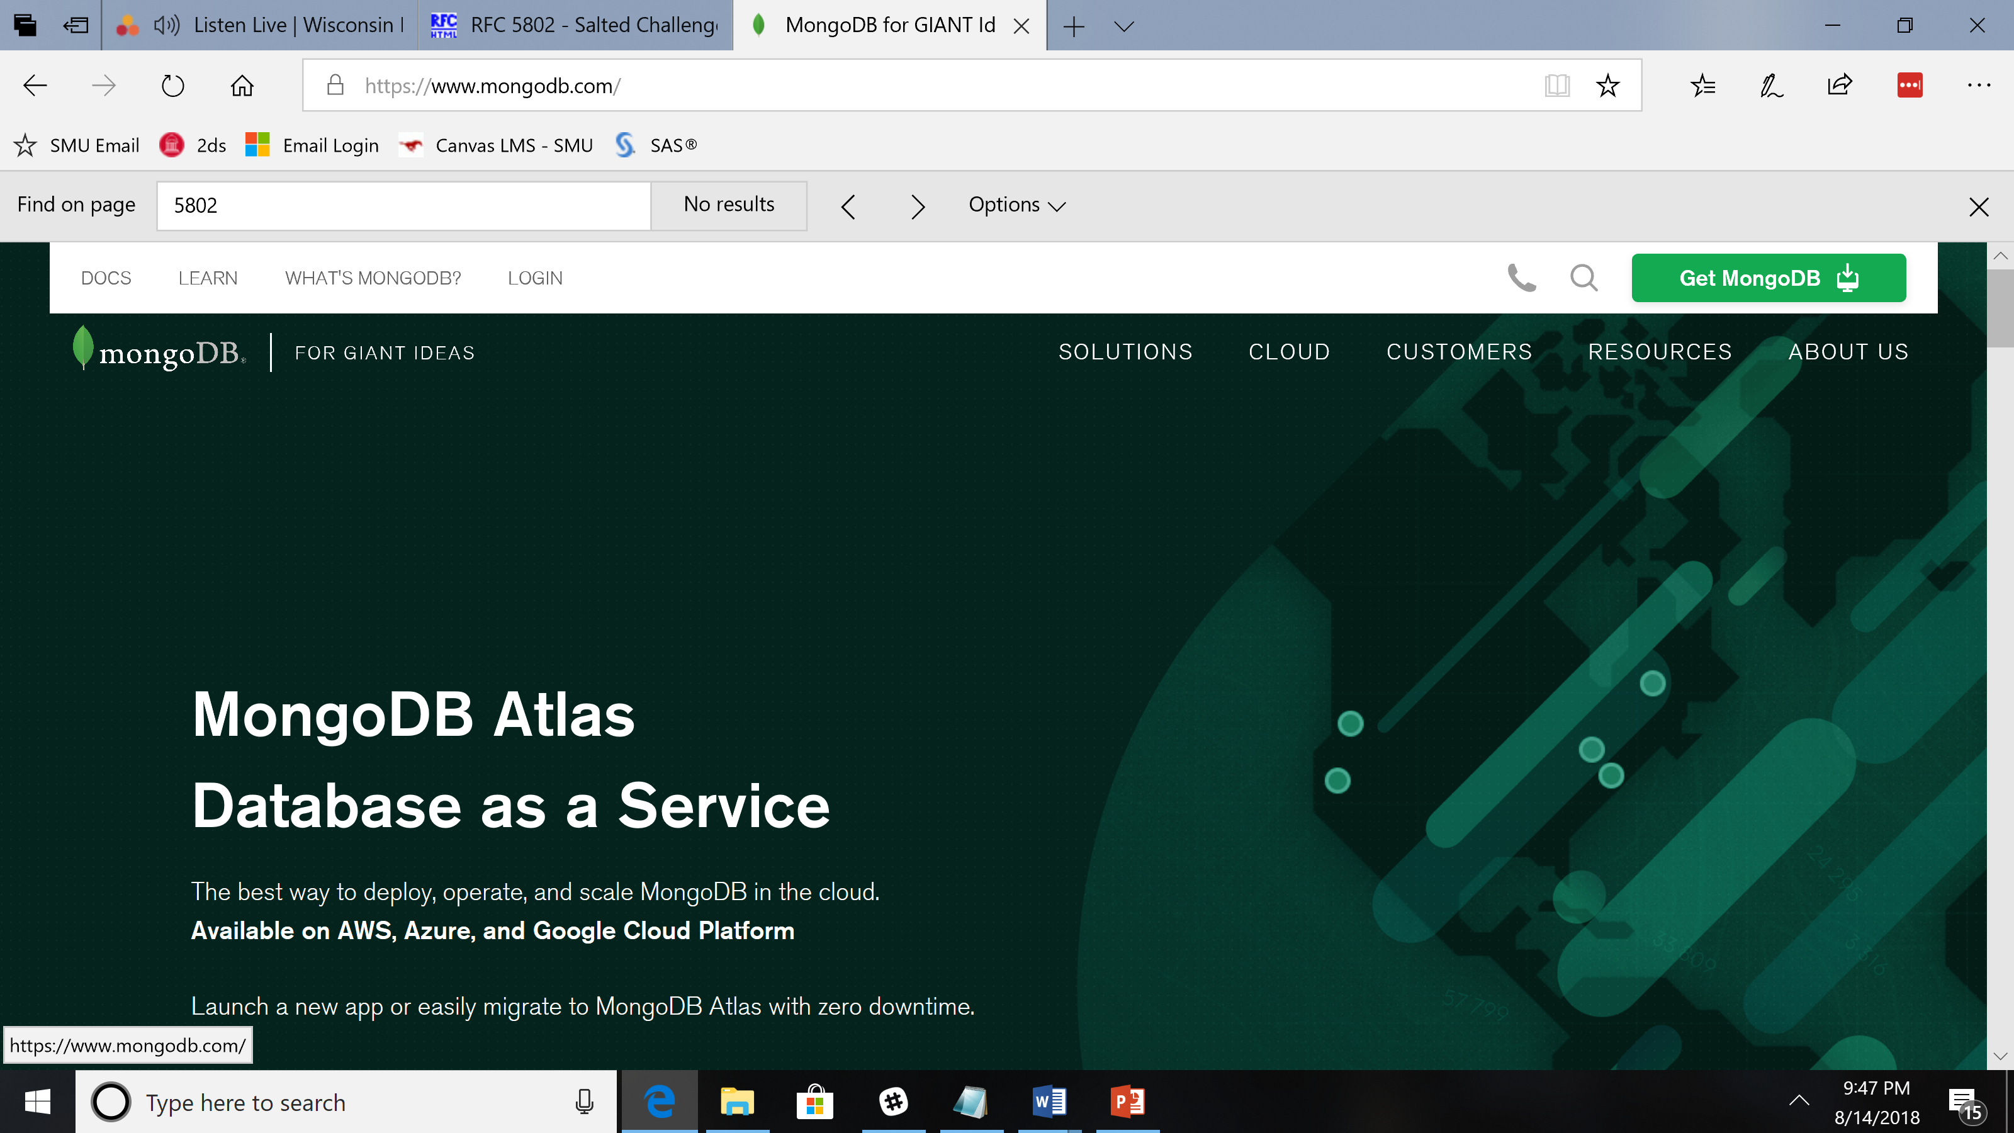
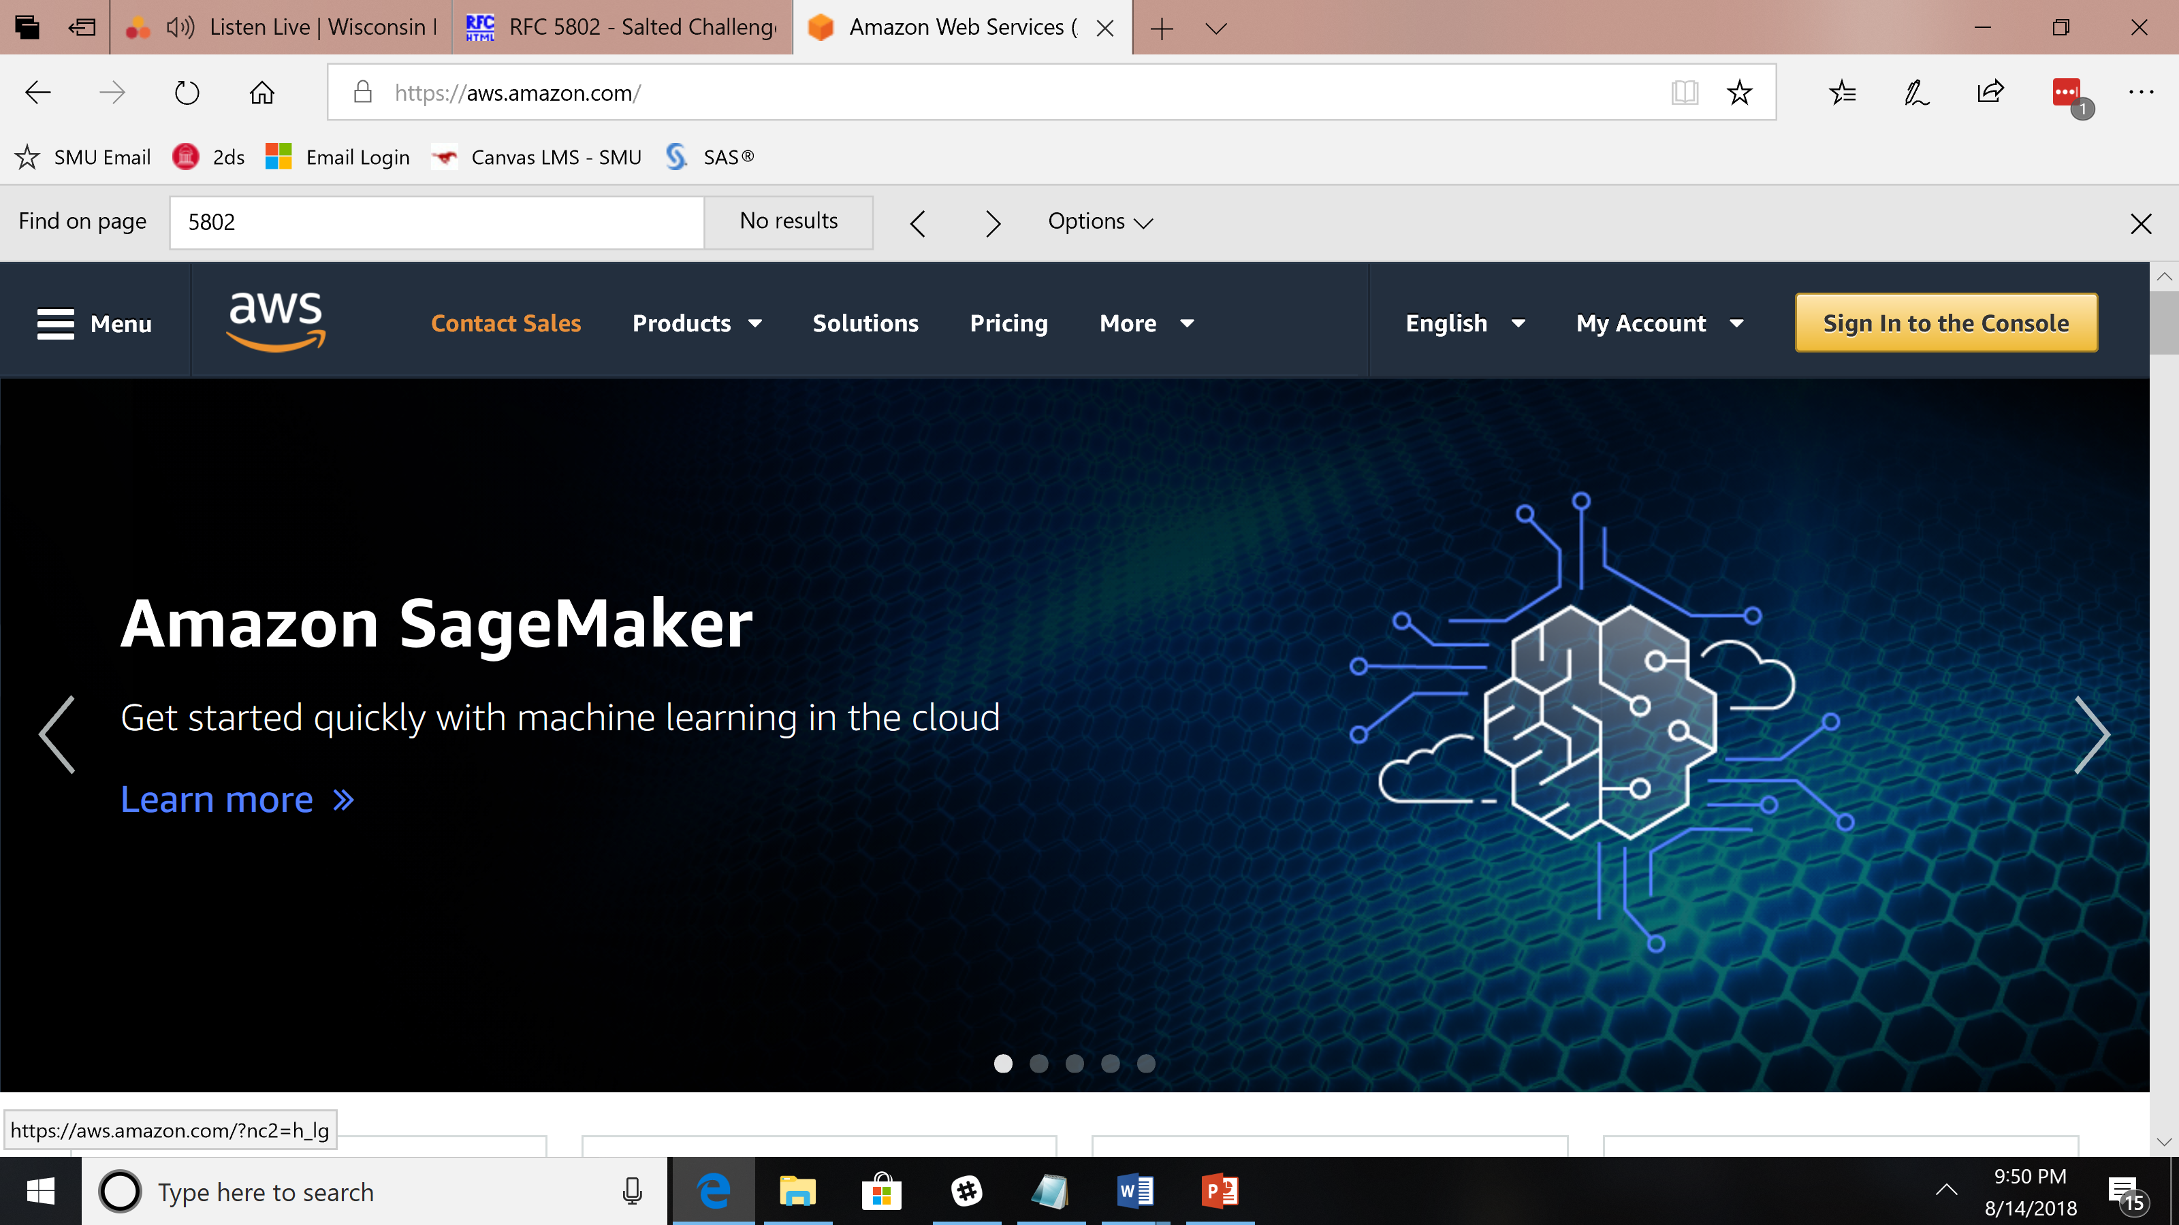
Key Resources, Tools, and Technology

Slide 16
Key Resources, Tools, and Technology
Whitelist IP addresses
Encryption in transit
Encryption at rest
Authorization/Authentication
Two-factor Authentication
Mongo Compass

Slide 17
GUI for Cloud Options
Atlas
Sets Authentication/Authorization for Cloud
Provides AES256 (data at rest encryption)
Provides TSL/SSL (data-in-transit encryption)

Slide 18
Allow authenticated users
Local GUI for databases
Run queries
Compass
Uploads data via CSV and JSON only
Set user permissions per database

Slide 19
Key Resources, Tools, and Technology
Manages keys for encryption at rest
Multi-factor Authentication
AWS S3 (Simple Storage Service)

Slide 20
Stores Video
Stores Audio
Stores Text
Provides Encryption Keys
Manages Keys

Slide 21
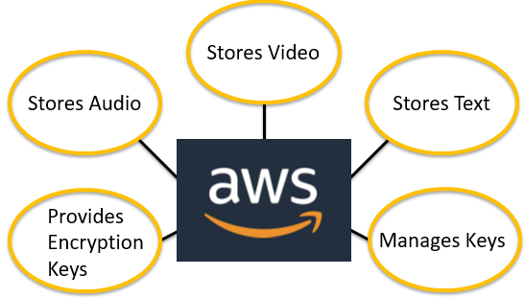
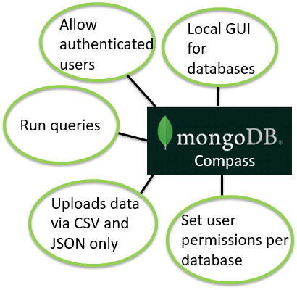
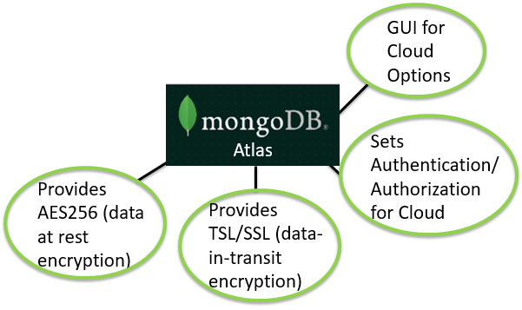

Slide 22
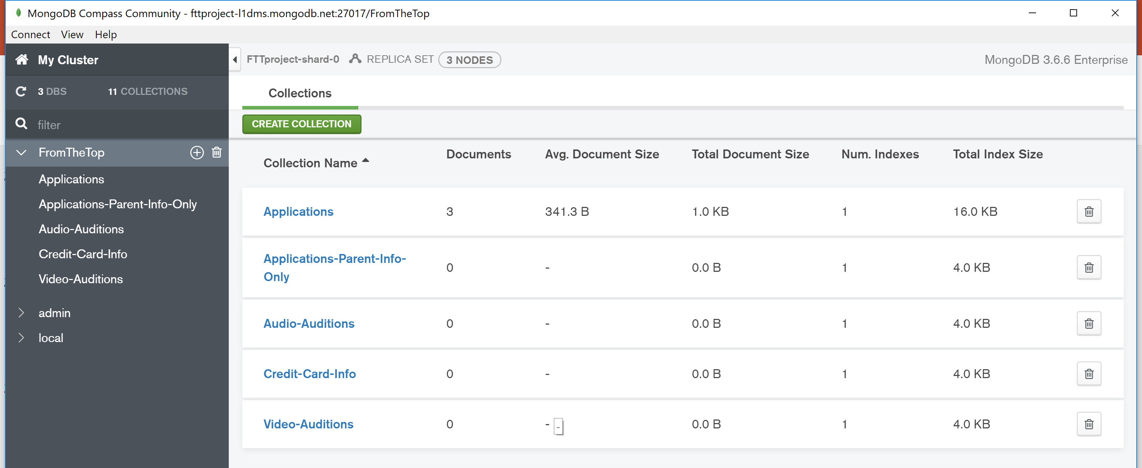
Database Development Methodology

Slide 23
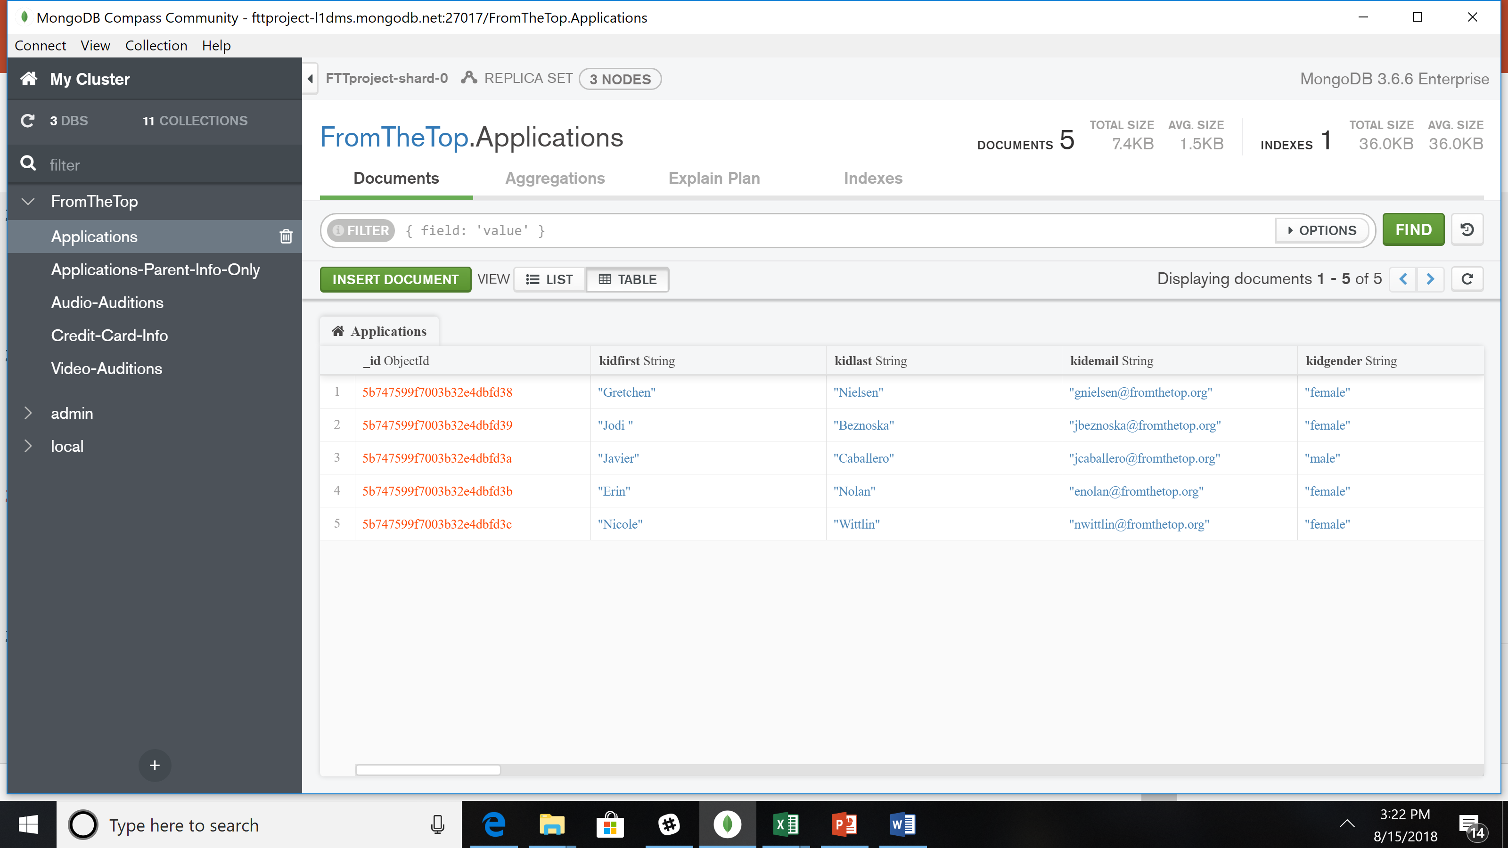
Database Development Methodology

Slide 24
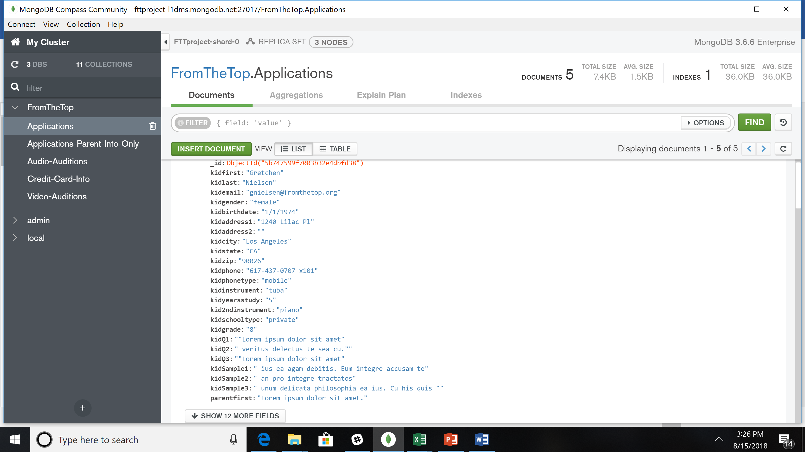
Database Development Methodology

Slide 25
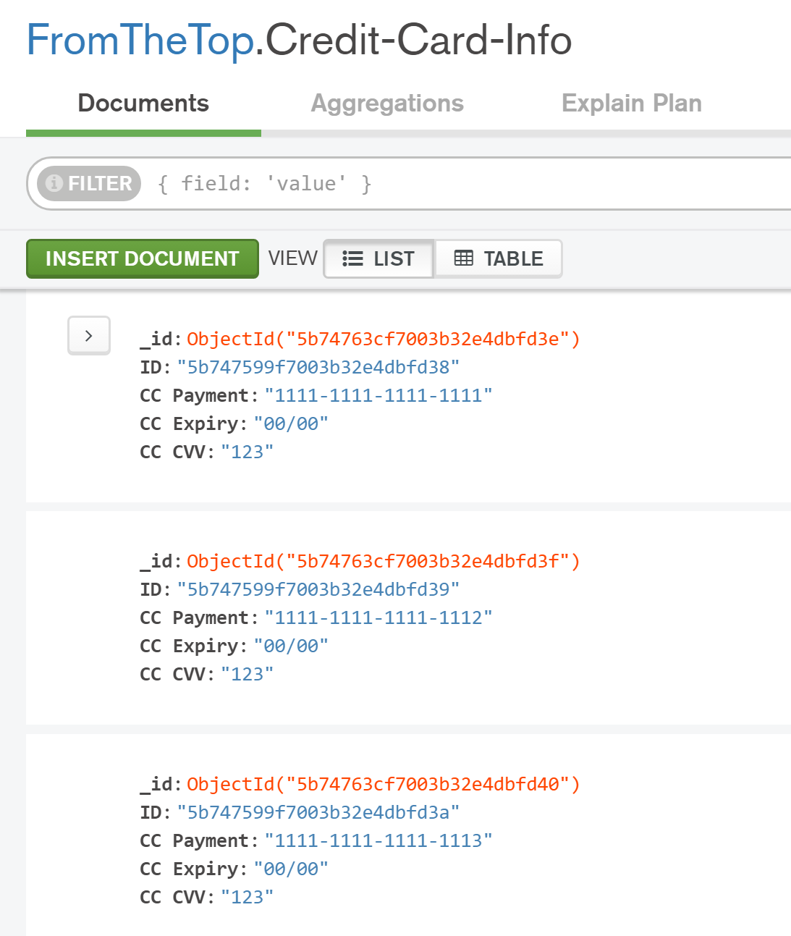
Database Development Methodology

Slide 26
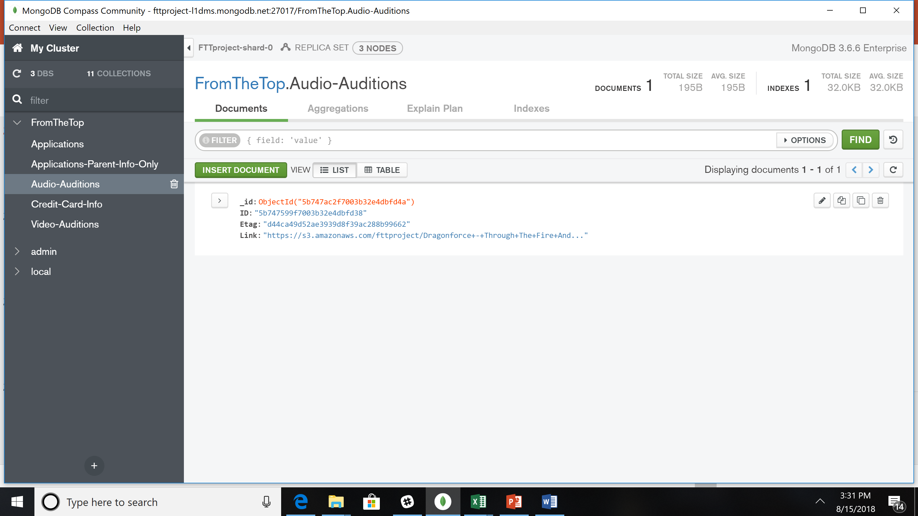
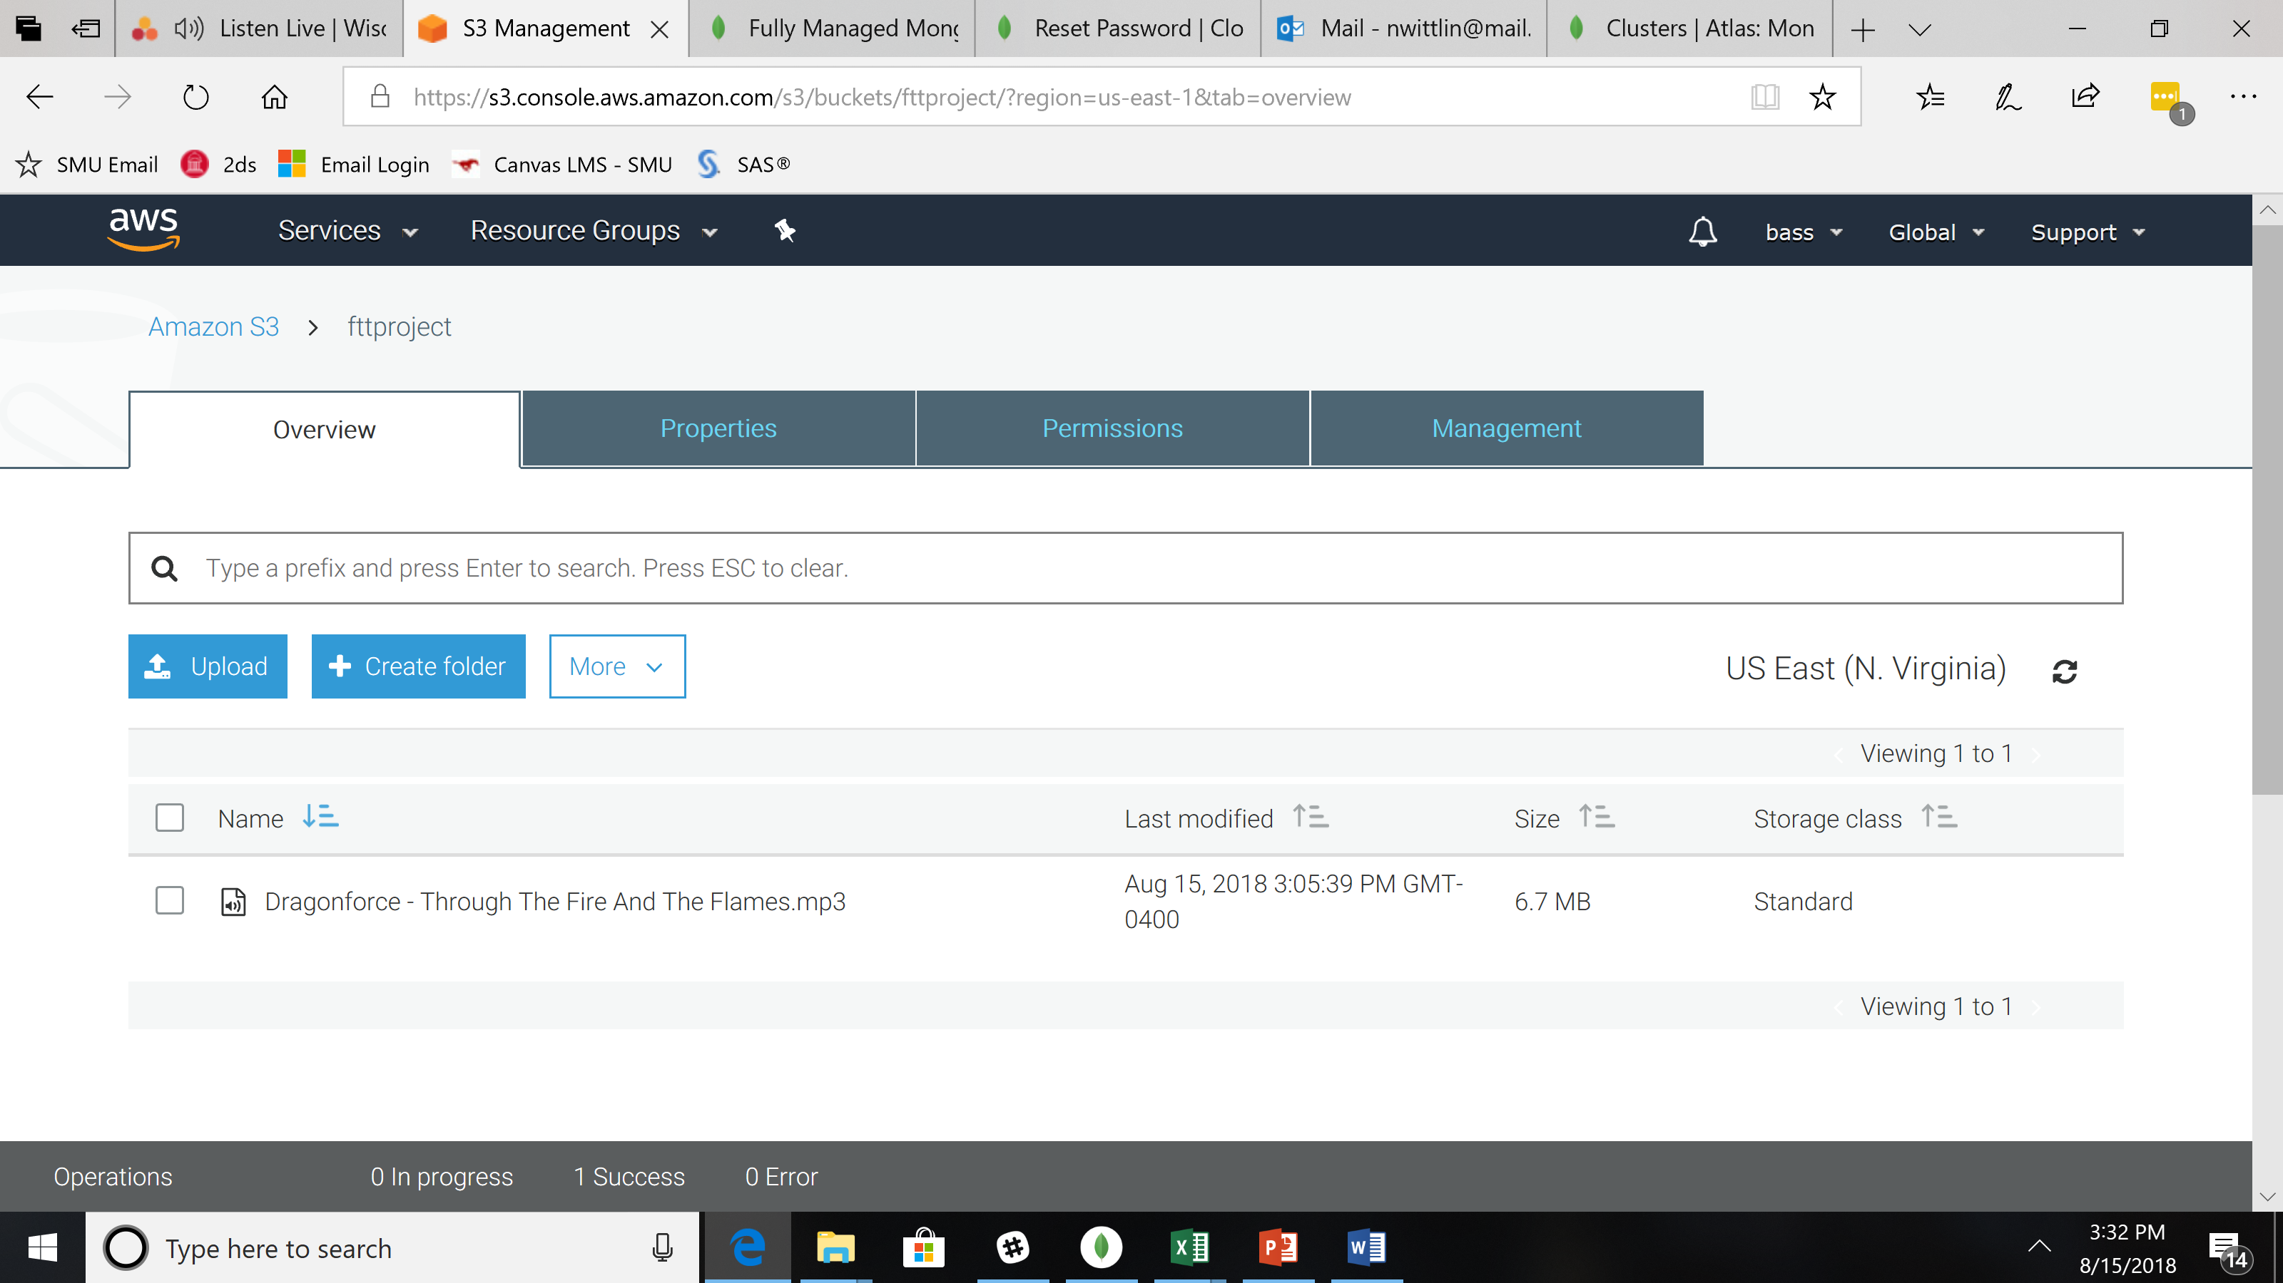
Database Development Methodology

Slide 27
Future Work
Build out MongoDB Atlas sample database for production
Conduct Cost Evaluation
Further train FTT staff in MongoDB
Set up common queries and analysis for team
Research, scope, and price web-based “form” to securely accept applications and feed to MongoDB

Slide 28
Questions and Comments

